Slide 1

Business Analytics minor
Week 6: Evaluation
Credit: dr. Seppe vanden Broucke

Slide 2
Model Validation
What is validity? Are the outputs of the model an acceptable representation of the real world?
Does the model fit the business question?
Does the model fit existing and unseen data?
Types of Validity
Apparent (own sample) -> training set
Internal (own population) - > validation set
External (other population) -> test set
Split the date into 2 or more samples to ensure model validity.

Slide 3
Model Validation
Business Relevance
Answer the right question? Can we do something with the results?
In cooperation with the business users
Operational Efficiency and Economic Cost
Time to train vs time to predict, Cost to gather necessary data, Maintenance (retraining models)
Regulatory Compliance
Ethics, Discrimination, “black box” vs “white box” models, Privacy
Statistical Performance
The remainder of this presentation will cover performance metrics

Slide 4
Performance of
Classification Models

Slide 5
Confusion Matrix (review)
Accuracy:
True Positive + True Negative
Total
Precision/Positive Predictive Value:
True Positive
All Positive Predictions
Recall/Sensitivity/True Positive Rate:
True Positive
All Actual Positives
Specificity/True Negative Rate:
True Negative
All Actual Negatives
Actual Class
True Positive
False Positive
All Positive Predictions
Predicted Class
False Negative
True Negative
All Negative Predictions
All Actual Positives
All Actual Negatives

Slide 6
Regression to Classification
Remember: we used the confusion matrix, accuracy, precision, recall, sensitivity and specificity to evaluate classification models (discrete target variable)
Imagine you have a regression model (continuous target variable) that outputs the probability an instance belongs to a particular class
By setting a threshold or cutoff value, you can use it to classify instances following this rule:
If prediction > threshold, predict C, else predict Not C.

Slide 7
Probability Threshold
Actual Label | Predicted Probability | Threshold = 0.5 | Threshold = 0.7
no | 0.11 | no | no
no | 0.20 | no | no
yes | 0.85 | yes | yes
yes | 0.84 | yes | yes
yes | 0.80 | yes | yes
no | 0.65 | yes | no
yes | 0.44 | no | no
no | 0.10 | no | no
yes | 0.32 | no | no
yes | 0.87 | yes | yes
yes | 0.61 | yes | no
yes | 0.60 | yes | no
yes | 0.78 | yes | yes
no | 0.61 | yes | no
T = 0.5 | Predicted Yes | Predicted No
Actual Yes | 7 | 2 | 9
Actual No | 2 | 3 | 5
 | 9 | 5
T = 0.7 | Predicted Yes | Predicted No
Actual Yes | 5 | 4 | 9
Actual No | 5 | 0 | 5
 | 10 | 4

Slide 8
Probability Threshold
T = 0.5 | Predicted Yes | Predicted No
Actual Yes | 7 | 2 | 9
Actual No | 2 | 3 | 5
 | 9 | 5
T = 0.7 | Predicted Yes | Predicted No
Actual Yes | 5 | 4 | 9
Actual No | 5 | 0 | 5
 | 10 | 4
Accuracy = 10 correct/ 14 total = 0.71
Recall = 7 true yes / 9 actual yes = 0.78
Precision = 7 true yes / 9 predicted yes = 0.78
Accuracy = 5 correct/ 14 total = 0.36
Recall = 5 true yes / 9 actual yes = 0.56
Precision = 5 true yes / 10 predicted yes = 0.50

Slide 9
Choosing a Probability Threshold
Actual Label | Predicted Probability
no | 0.11
no | 0.20
yes | 0.85
yes | 0.84
yes | 0.80
no | 0.65
yes | 0.44
no | 0.10
yes | 0.32
yes | 0.87
yes | 0.61
yes | 0.60
yes | 0.78
no | 0.61
Predicted Probability (Ordered) | TP | FP | TN | FN
0.1 | 9 | 5 | 0 | 0
0.11 | 9 | 4 | 1 | 0
0.20 | 9 | 3 | 2 | 0
0.32 | 9 | 2 | 3 | 0
0.44 | 8 | 2 | 3 | 1
0.60 | 7 | 2 | 3 | 2
0.61 | 6 | 2 | 3 | 3
0.65 | 5 | 1 | 4 | 4
0.78 | 5 | 0 | 5 | 4
0.80 | 4 | 0 | 5 | 5
0.84 | 3 | 0 | 5 | 6
0.85 | 2 | 0 | 5 | 7
0.87 | 1 | 0 | 5 | 8
Remove duplicate probabilities and order from smallest to greatest
Each of these values is a possible threshold
Determine the confusion matrix for each possible threshold

Slide 10
Choosing a Probability Threshold
Predicted Probability (Ordered) | TP | FP | TN | FN
0.1 | 9 | 5 | 0 | 0
0.11 | 9 | 4 | 1 | 0
0.20 | 9 | 3 | 2 | 0
0.32 | 9 | 2 | 3 | 0
0.44 | 8 | 2 | 3 | 1
0.60 | 7 | 2 | 3 | 2
0.61 | 6 | 2 | 3 | 3
0.65 | 5 | 1 | 4 | 4
0.78 | 5 | 0 | 5 | 4
0.80 | 4 | 0 | 5 | 5
0.84 | 3 | 0 | 5 | 6
0.85 | 2 | 0 | 5 | 7
0.87 | 1 | 0 | 5 | 8
Plot the accuracy for each possible threshold

Slide 11
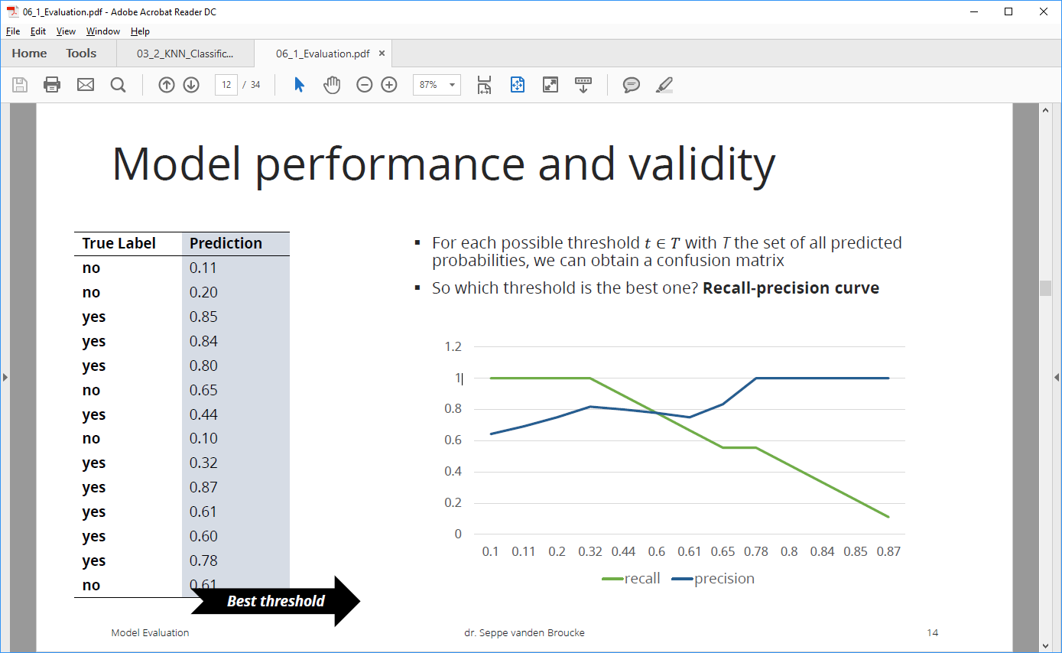
Choosing a Probability Threshold
Predicted Probability (Ordered) | TP | FP | TN | FN
0.1 | 9 | 5 | 0 | 0
0.11 | 9 | 4 | 1 | 0
0.20 | 9 | 3 | 2 | 0
0.32 | 9 | 2 | 3 | 0
0.44 | 8 | 2 | 3 | 1
0.60 | 7 | 2 | 3 | 2
0.61 | 6 | 2 | 3 | 3
0.65 | 5 | 1 | 4 | 4
0.78 | 5 | 0 | 5 | 4
0.80 | 4 | 0 | 5 | 5
0.84 | 3 | 0 | 5 | 6
0.85 | 2 | 0 | 5 | 7
0.87 | 1 | 0 | 5 | 8
Plot the recall and precision for each possible threshold

Slide 12
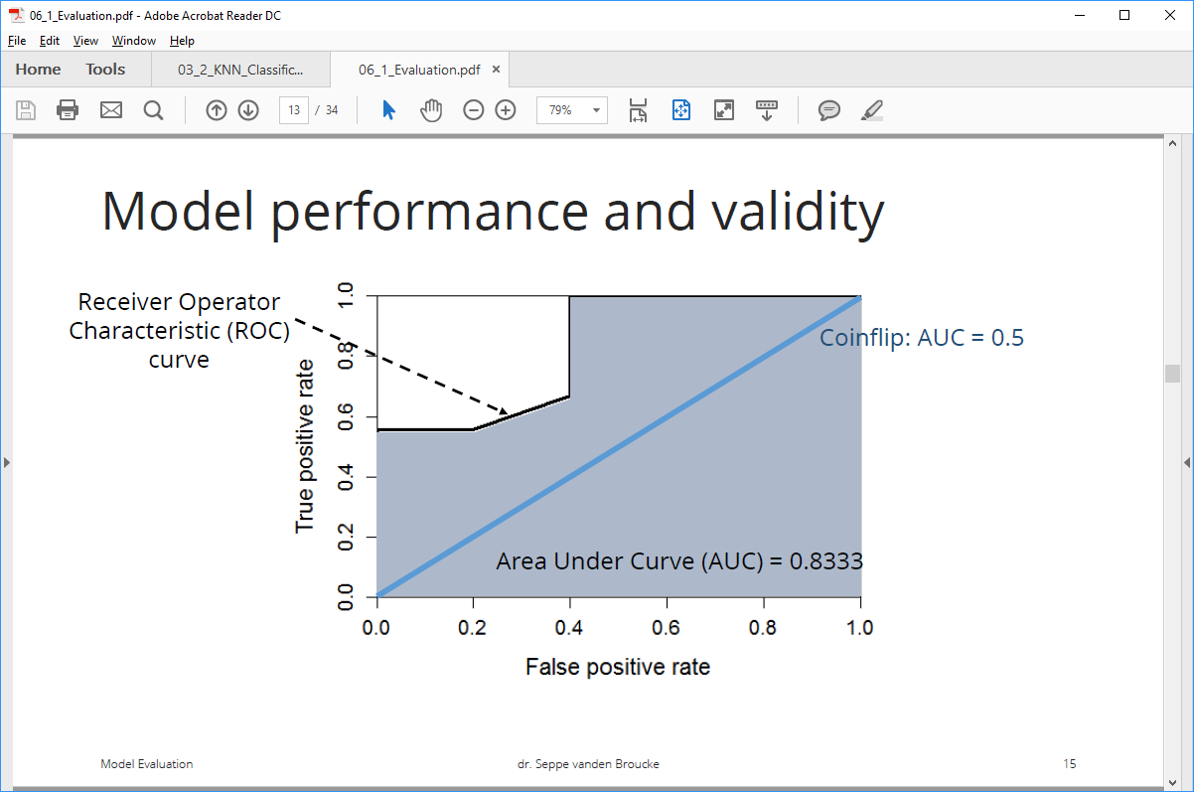
ROC-Curve
The Receiver Operator Characteristic (ROC) curve plots the True Positive Rate (Sensitivity) versus the False Positive Rate (1 – Specificity).
Predicted Probability (Ordered) | TP | FP | TN | FN
0.1 | 9 | 5 | 0 | 0
0.11 | 9 | 4 | 1 | 0
0.20 | 9 | 3 | 2 | 0
0.32 | 9 | 2 | 3 | 0
0.44 | 8 | 2 | 3 | 1
0.60 | 7 | 2 | 3 | 2
0.61 | 6 | 2 | 3 | 3
0.65 | 5 | 1 | 4 | 4
0.78 | 5 | 0 | 5 | 4
0.80 | 4 | 0 | 5 | 5
0.84 | 3 | 0 | 5 | 6
0.85 | 2 | 0 | 5 | 7
0.87 | 1 | 0 | 5 | 8
The Area Under the Receiver Operator Characteristic Curve (AUC) can be used to compare models. An AUC closest to 1 is considered a better model. This would represent 100% true positive and 0.0% false positive.

Slide 13
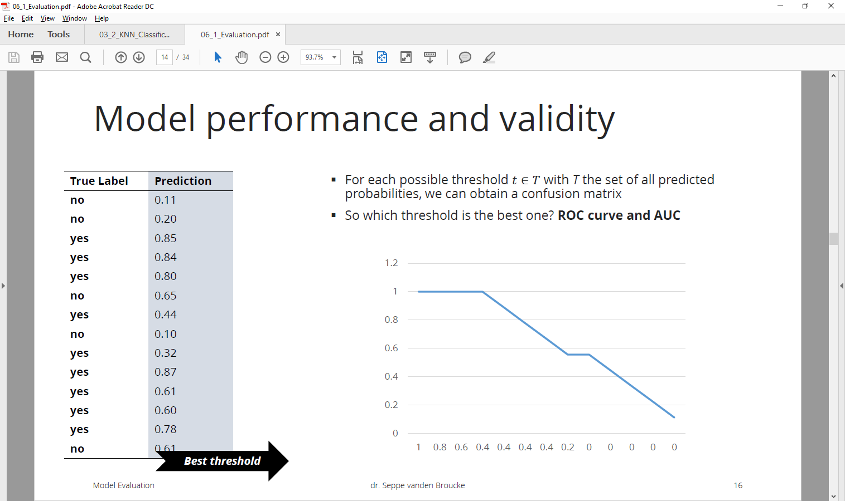
ROC-Curve
True positive rate
False positive rate

Slide 14
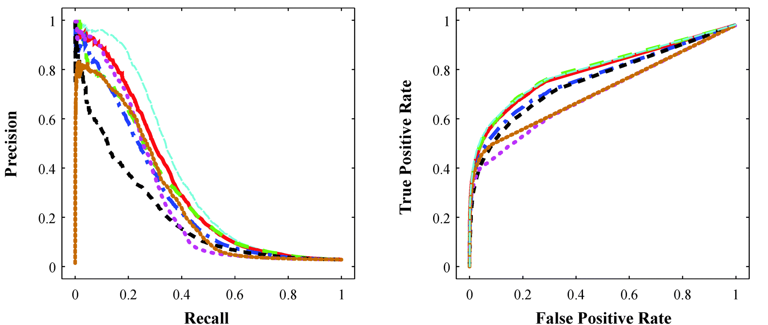
Precision v Recall, TPR v FPR

Slide 15
Lift Curve
Lift looks at the “most likely candidates” identified by a model. For example, if we take the top 5% based on predicted probability, how many of them are actually true. Lift = % of class in top segment / % of class in all data
Actual Label | Predicted Probability
no | 0.11
no | 0.20
yes | 0.85
yes | 0.84
yes | 0.80
no | 0.65
yes | 0.44
no | 0.10
yes | 0.32
yes | 0.87
yes | 0.61
yes | 0.60
yes | 0.78
no | 0.61

Slide 16
Misclassification Costs
Consider again the confusion matrix:
There might be higher costs associate with certain errors (and greater benefit with certain correct predictions)
Imagine this test predicts cancer:
Which is worse? False Positive or False Negative?
Which is better? A True Positive or True Negative?
T = 0.5 | Predicted Yes | Predicted No
Actual Yes | 7 | 2 | 9
Actual No | 2 | 3 | 5
 | 9 | 5

Slide 17
Validating a Model

Slide 18
Overfitting
Remember: we want good results on unseen instances, not just the training data
Use a training, validation, and test sets

Slide 19
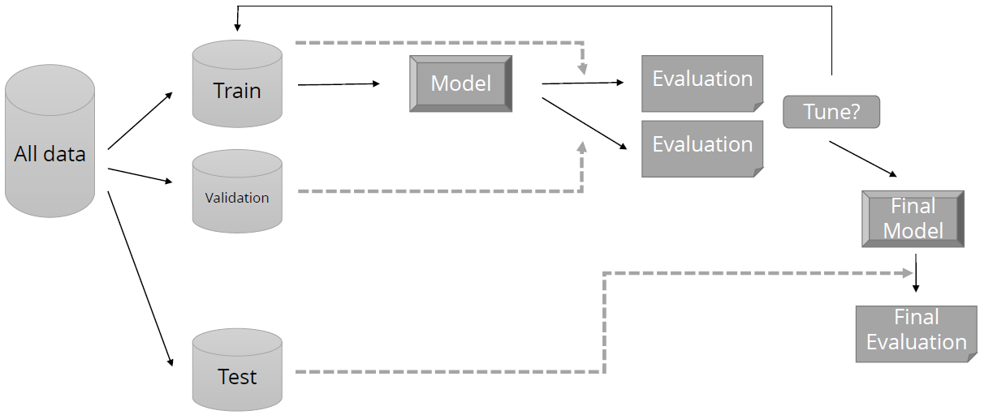
Train, Validation, Test Sets

Slide 20
Cross Validation
Validate
Split 1
Train
Train
Validate
Split 2
Train
Split 3
Validate

Slide 21
Cross Validation
K-Fold:
Split data into training and test sets
Split training set into k subsets
Leave one subset for validation and train on all other sets
Repeat k times, always using a different validation set
Choose the best model
Evaluate “best” model on original test set
Leave One Out:
k = number of instances
Leave one instance for validation and train on remaining training set
Repeat for all instances

Slide 22
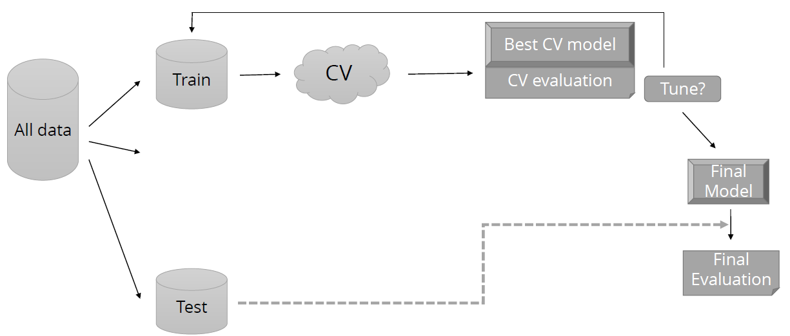
Training with Cross Validation

Slide 23
Examples
and Illustrations

Slide 24
During the first KDD Cup 1997, the goal was to select a subset of lapsed donors to contact. An entry from one well-known company selected the worst possible candidates for mailing - their results were significantly worse than random! Apparently their dataminers switched the sign somewhere. Fortunately for them, the names of the contestants were kept anonymous.
~(Gregory Piatetsky-Shapiro)

Slide 25
In the 1980s, the Pentagon wanted to harness computer technology to make their tanks harder to attack.
The preliminary plan was to fit each tank with a digital camera hooked up to a computer. The computer would continually scan the environment outside for possible threats (such as an enemy tank hiding behind a tree), and alert the tank crew to anything suspicious. The only possible way to solve the problem was to employ a neural network. The research team went out and took 100 photographs of tanks hiding behind trees, and then took 100 photographs of trees - with no tanks. They took half the photos from each group and put them in a vault for safe-keeping, then scanned the other half into their mainframe computer. The huge neural network was fed each photo one at a time and asked if there was a tank hiding behind the trees. Over time it got better and better until eventually it was getting each photo correct. It could correctly determine if there was a tank hiding behind the trees in any one of the photos.
But the scientists were worried: had it actually found a way to recognize if there was a tank in the photo, or had it merely memorized which photos had tanks and which did not? So the scientists took out the photos they had been keeping in the vault and fed them through the computer. To their immense relief the neural net correctly identified each photo as either having a tank or not having one.
The Pentagon was very pleased with this, but a little bit suspicious. They commissioned another set of photos (half with tanks and half without) and scanned them into the computer and through the neural network. The results were completely random. For a long time nobody could figure out why. After all nobody understood how the neural had trained itself.
Eventually someone noticed that in the original set of 200 photos, all the images with tanks had been taken on a cloudy day while all the images without tanks had been taken on a sunny day. The neural network had been asked to separate the two groups of photos and it had chosen the most obvious way to do it - not by looking for a camouflaged tank hiding behind a tree, but merely by looking at the color of the sky. The military was now the proud owner of a multi-million dollar mainframe computer that could tell you if it was sunny or not.

Slide 26
In pre-Big Data days, for example, a hotel chain used some pretty sophisticated mathematics, data mining, and time series analysis to coordinate its yield management pricing and promotion efforts. The forecasting models—which were marvels—mapped out revenues and margins by property and room type. The projections worked fine for about a third of the hotels but were wildly, destructively off for another third.
The forensics took weeks; the data were fine. Were competing hotels running unusual promotions that screwed up the model? Nope. For the most part, local managers followed the yield management rules.
Almost five months later, after the year’s financials were totally blown and HQ’s credibility shot, the most likely explanation materialized: The modeling group—the data scientists of the day—had priced against the hotel group’s peer competitors. They hadn’t weighted discount hotels into either pricing or room availability. For roughly a quarter of the properties, the result was both lower average occupancy and lower prices per room (Learn from Your Analytics Failures, HBR)

Slide 27
Any questions?
Credit: dr. Seppe vanden Broucke, UGent and KULeuven

